Slide 1
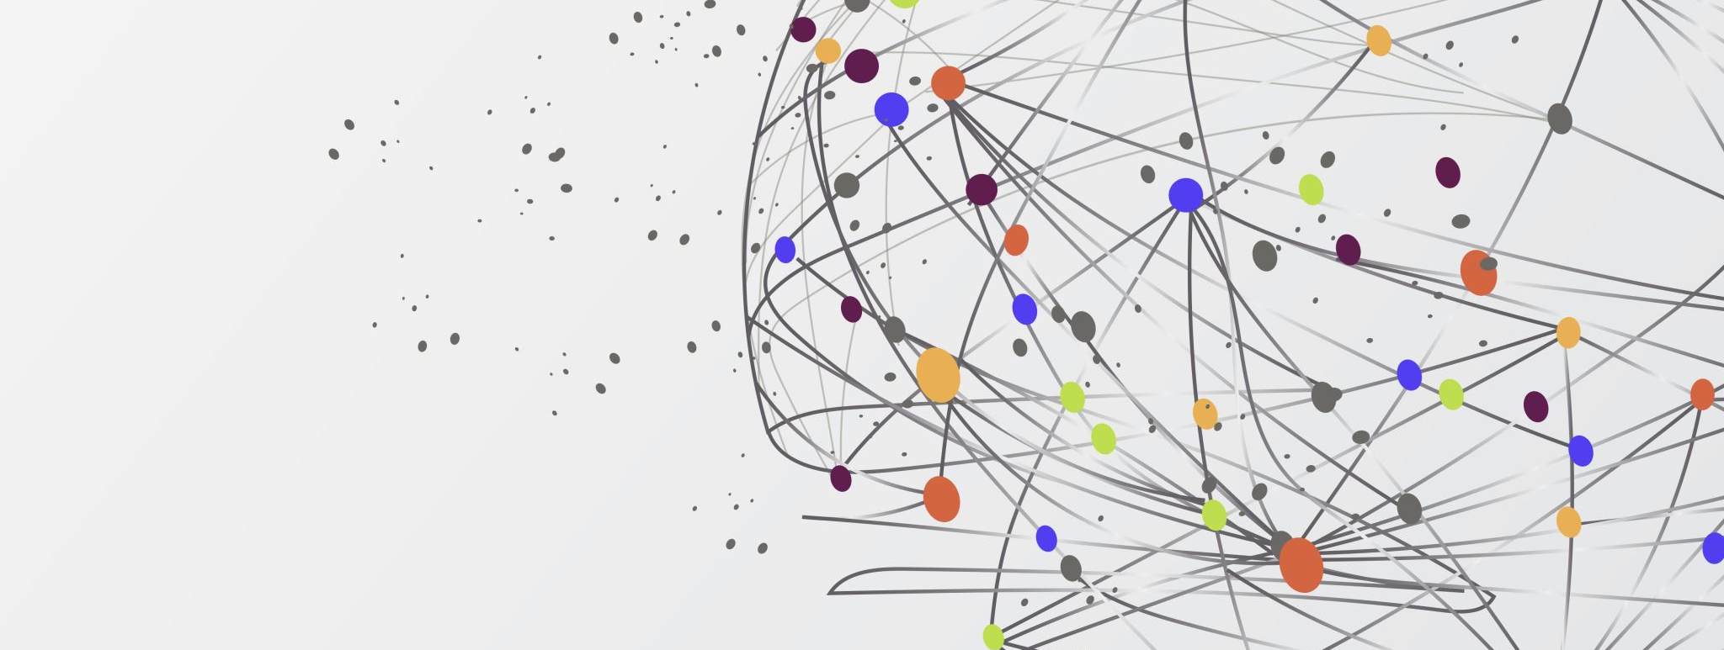
Graph Attention Networks
Presented by Marius-Andrei Murariu

Slide 2
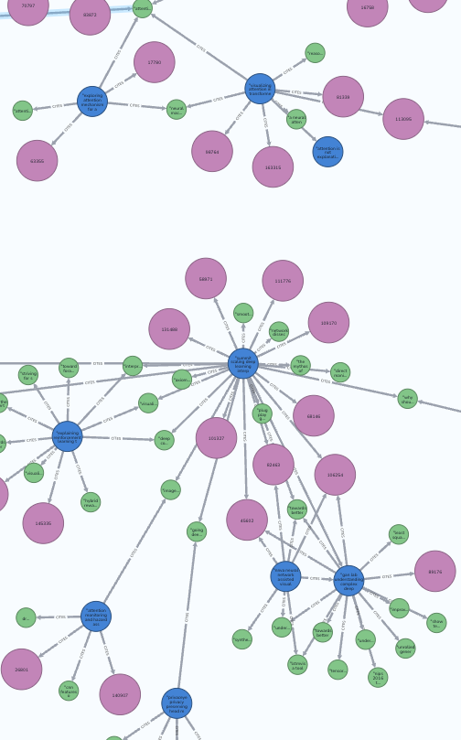
Graph Attention Networks
Petar Veličković et al., 2017
able to process both directed and undirected graphs
can be used on arbitrarily structured graphs

Slide 3
Advantages
parallelizable across neighbours
can be applied to graph nodes with different degrees
can be used in both transductive and inductive learning problems

Slide 4
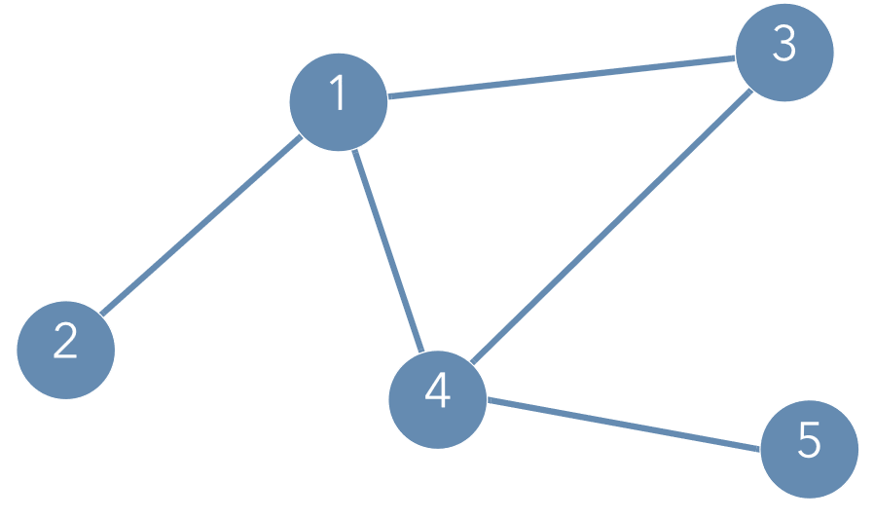
Graph Embeddings
 | 1 | 2 | 3 | 4 | 5
1 | 1 | 1 | 1 | 1 | 0
2 | 1 | 1 | 0 | 0 | 0
3 | 1 | 0 | 1 | 1 | 0
4 | 1 | 0 | 1 | 1 | 1
5 | 0 | 0 | 0 | 1 | 1
0.7 | 3 | 0.5 | 1.4
Sample graph with N = 5 nodes
Adjacency matrix

Slide 5
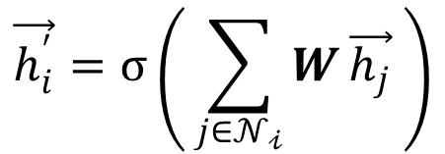
Graph Neural Networks
$$\vec{h_{i}^{′}}=σ\left( \sum_{j∈𝒩_{𝒾}}{W}\vec{h_{j}} \right)$$
1 | 1 | 1 | 1 | 0
1 | 1 | 0 | 0 | 0
1 | 0 | 1 | 1 | 0
1 | 0 | 1 | 1 | 1
0 | 0 | 0 | 1 | 1
h₁
h₂
h₃
h₄
h₅
h₁’
h₂’
h₃’
h₄’
h₅’
Adjacency matrix
Feature vectors
Learnable weight matrix W
New node embeddings
[ N, N ]
[ N, F ]
[ F, F’ ]
[ N, F’ ]

Slide 6
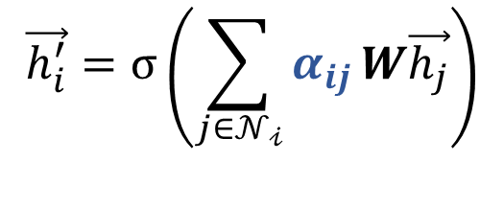
Graph Neural Networks
$$\vec{h_{i}^{′}}=σ\left(\sum_{j∈𝒩_{𝒾}}{α_{ij}}W\vec{h_{j}}\right)$$
1 | 1 | 1 | 1 | 0
1 | 1 | 0 | 0 | 0
1 | 0 | 1 | 1 | 0
1 | 0 | 1 | 1 | 1
0 | 0 | 0 | 1 | 1
h₁
h₂
h₃
h₄
h₅
h₁’
h₂’
h₃’
h₄’
h₅’
Adjacency matrix
Feature vectors
Learnable weight matrix W
New node embeddings
[ N, N ]
[ N, F ]
[ F, F’ ]
[ N, F’ ]

Slide 7
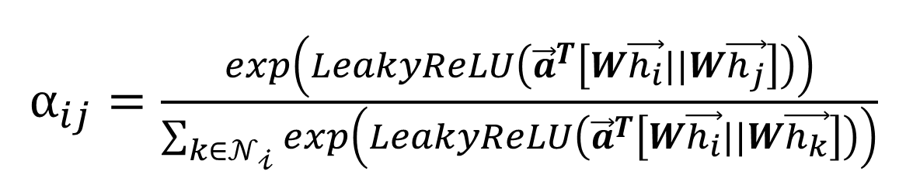
The Attention Mechanism
$α_{ij}=\frac{exp\left(LeakyReLU\left({\vec{a}}^{T}\left[W\vec{h_{i}}||W\vec{h_{j}}\right]\right)\right)}{\sum_{k∈𝒩_{𝒾}}{exp\left(LeakyReLU\left({\vec{a}}^{T}\left[W\vec{h_{i}}||W\vec{h_{k}}\right]\right)\right)}}$
a^{T}
W h_{i}
e_{ij}
Leaky ReLU
softmax_{j}
α_{ij}
W h_{j}
$$j∈𝒩_{𝒾}$$

Slide 8
Multihead Attention
W ^{(k)}h_{i}
e_{ij} ^{(k)}
Leaky ReLU
α _{ij}^{(k)}
K
softmax_{j}
W ^{(k)} h_{j}
a^{T (k)}
$$j∈𝒩_{𝒾}$$

Slide 9
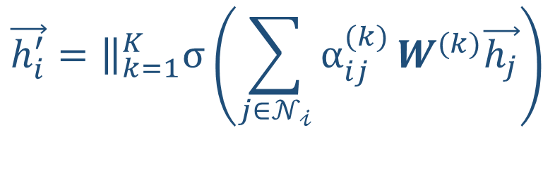
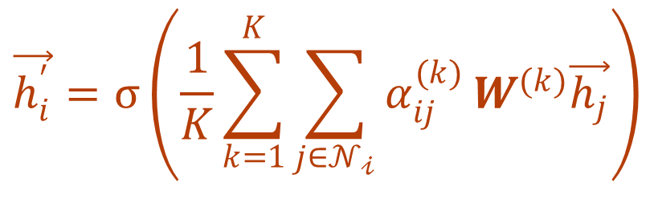
Multihead Attention
$$\vec{h_{i}^{′}}=σ\left(\frac{1}{K}\sum_{k=1}^{K}{\sum_{j∈𝒩_{𝒾}}{α_{ij}^{(k)}}}W^{(k)}\vec{h_{j}}\right)$$
$$\vec{h_{i}^{′}}={\left.​\right\|}_{k=1}^{K}σ\left(\sum_{j∈𝒩_{𝒾}}{α_{ij}^{(k)}}W^{(k)}\vec{h_{j}}\right)$$
Feature concatenation
Intermediate layers
Feature averaging
Final layer

Slide 10
Model Architecture – Transductive learning
output
GAT Layer
K = 8 attention heads
output dimension F’ = 8
ELU nonlinearity
GAT Layer
K = 1 attention heads
computes C features
softmax activation
Softmax
GAT Layer
1 attention heads
ELU
GAT Layer
8 attention heads
input

Slide 11
Model Architecture – Inductive learning
ELU
GAT Layers 1 + 2
K = 4 attention heads
output dimension F’ = 256
ELU nonlinearity
skip connection over layer 2
GAT Layer 3
K = 6 attention heads
feature averaging
logistic sigmoid activation
+
output
GAT Layer
4 attention heads
Logistic sigmoid
ELU
Average
GAT Layer
4 attention heads
GAT Layer
6 attention heads
input

Slide 12

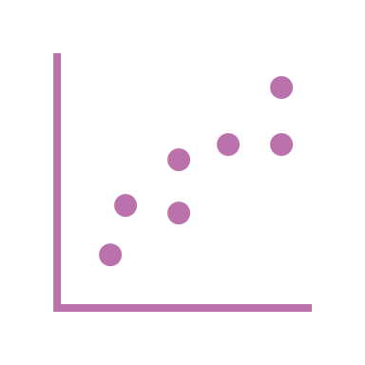

Model Training
L₂ regularization with λ = 0.0005
Dropout with p = 0.6
initial learning rate lr = 0.005
1200 training epochs
Glorot weight initialization
Adam SGD optimizer

Slide 13
Stated classification accuracies for transductive tasks
Method | Cora | Citeseer | Pubmed
MLP | 55.1% | 46.5% | 46.5%
DeepWalk (Perozzietal., 2014) | 67.2% | 43.2% | 65.3%
Planetoid (Yangetal., 2016) | 75.7% | 64.7% | 77.2%
Chebyshev (Defferrardetal., 2016) | 81.2% | 69.8% | 74.4%
GCN (Kipf & Welling, 2017) | 81.4 ± 0.5% | 70.9 ± 0.5% | 79.0 ± 0.3%
MoNet (Monti et al., 2016) | 81.7 ± 0.5% | – | 78.8 ± 0.3%
GAT | 83.0 ± 0.7% | 72.5 ± 0.7% | 79.0 ± 0.3%

Slide 14
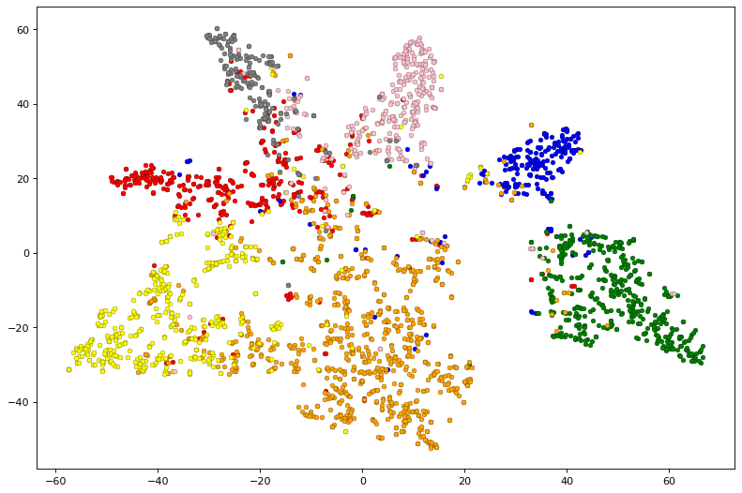
Training Results
Modelled the GAT architecture using PyTorch
Trained the model on the Cora dataset (2708 scientific publications, 7 classes)
Achieved 82.1 ± 0.6% test accuracy for node classification
Output embeddings

Slide 15
Thank you!

